Slide 1
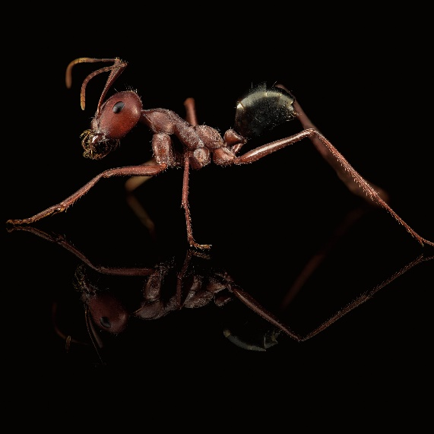


Distributed AI
Swarm intelligence - Annular sorting
Gabriele Rosati

Slide 2
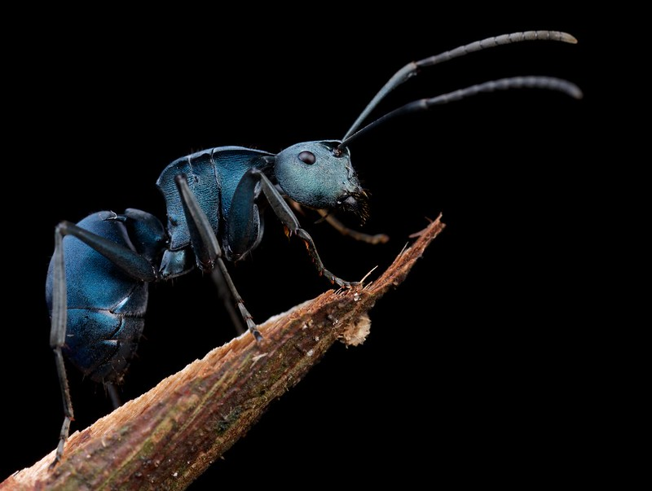
What is it ?
The main scope of this project is to show the concept of Collective intelligence. Such a phenomenon is observable by analyzing how ants interact with each other.
Local interactions between individuals lead to a global self-organized system’s behavior; note that swarm intelligence is not an «accident» but a property of a various systems due to natural evolution.

Slide 3
What is it ?
The project is inspired by an intriguing hypothesis concerning the nesting mechanism of Temnothorax colonies
The study showed that Temnothorax ants formed cluster of objects in the nest, placing smaller brood items at the center with a greater density, while the bigger ones are placed in the contour, forming an annular arrangement
This behavior is replied each time the ants were forced to migrate to a new nesting site

Slide 4
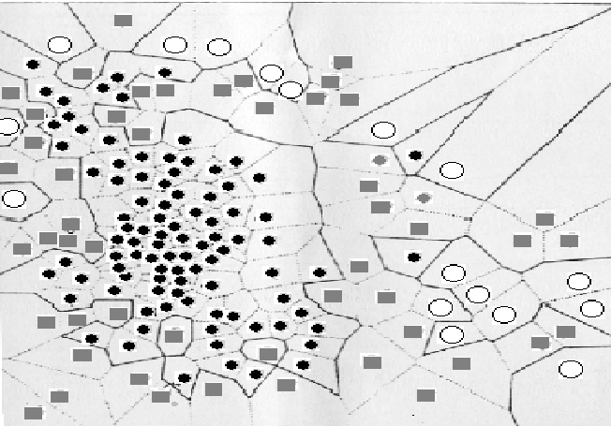
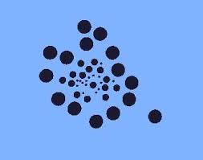
The goal:
Despite the exact mechanism that ants use to re-create these patterns is not fully known, we want to replicate the behaviour observed in Temnothorax colonies, where the broods were picked up and released forming a kind of annular structure, as shown by the pictures.

Slide 5
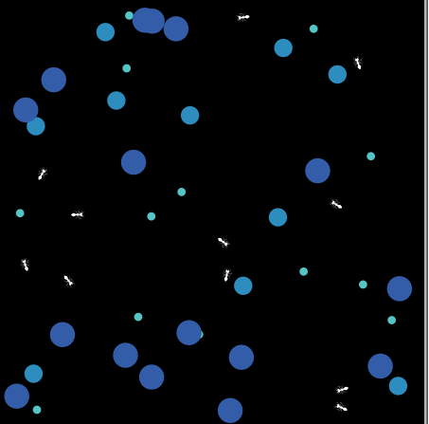
The experiment Specifications
General Context
The annular sort is a procedure applied to a distributed system composed of agents and objects.
Ants represent agents in the system, they can move around and pick up or drop items.
Brood items have different sizes, and represent the objects in the system.
Ants and Objects are spatially distributed at random on a 2 dimensional board reprensenting our living environment.
To decide if an agent should pick up or drop an objects, a «score» is computed for each one of them, considering its neighborhood.
Netlogo

Slide 6



The experiment Specifications
Objects
Location : position at each step (xcor and ycor)
Placement score (how good is my place?)
computed during collision by analyzing the neighborhood. It is dependent on the object’s minimum and maximum perimeter.
used to probabilistically determine if the agent should pick up or not the object
Size
Small, Medium, Big
Minimum and maximum perimeter,
the minimum acts as a «repulsive force», the maximum acts as a an «attractive force» (raction-repulsion model)

Slide 7
The experiment Specifications
Ants
Location (xcor, ycor)
Laden(?):
True or flase, defines if an ant is carryng an object or not
Energy:
Defines the lifespan of the agent. Each time the agent picks up an object the energy is reduced. That ant will die when the energy is 0.
Delay:
Used to simulate the ant roaming inside the nest. Before evaluating if an agent shoul drop or pick up an object, it must wait n-steps, where n is defined by the delay.This is the «cool down» dealy.

Slide 8
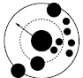
The experiment Specifications
The core algorithm
Laden ants carry objects around the environment and at every step (after delay) they evaluate what placement score the carried object would have if it were to be deposited at the current point. That score will be used to probabilistically determine whether the object should be dropped.
When evaluating the placement score of an object, the ant counts how many nearby objects fall within the minimum perimeter (these contributes with a predefined penalty) and how many fall within the maximum perimeter (these contributes with a predefined bonus).
As a result, groups of smaller objects will tend to «force out» larger objects.

Slide 9
The experiment Specifications
The core algorithm
Laden ants carry objects around the environment and at every step (after delay) they evaluate what placement score the carried object would have if it would be deposited at the current point. That score will be used to probabilistically determine whether the object should be dropped.
When evaluating the placement score of an object, the ant counts how many nearby objects fall within the minimum perimeter (these contributes with a predefined penalty) and how many fall within the maximum perimeter (these contributes with a predefined bonus).
As a result groups of smaller objects will tend to «force out» larger objects.
Pheromone ?

Slide 10
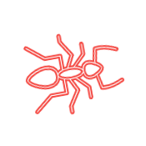
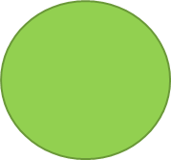



The experiment Specifications
The core algorithm
Should I drop it here?

Slide 11




The experiment Specifications
The core algorithm
Some objects are within the minimum perimeter.

Slide 12
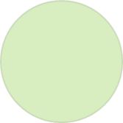
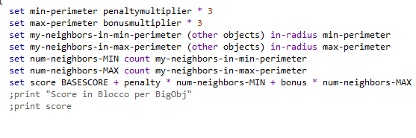

The experiment Specifications
The core algorithm
Let’s compute the score:
For each neighbor Object Ni
if (Ni.Location in Minimum_perimeter)
Score = Score - PENALTY
else
if (Ni.Location in Maximum_perimetrer)
Score = Score + BONUS
end for
Return (Score)

Slide 13
The experiment Specifications
The core algorithm
Let’s compute the score:
Probability = Random(0...1)
If (Score > Probability)
Drop here the object
Set the ant as not Laden
Delay = 4 (cool down the ant)

Slide 14
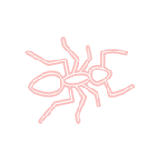
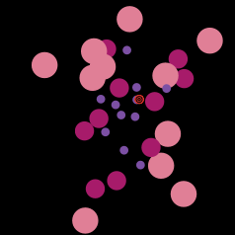



Algorithm performance
Separation
Separation is expressed as a percentage, with a value of 100% being interpreted as ideal. Separation measures the degree to which objects of similar size are kept apart from objects of different size (i.e., the degree of “segregation”).
For each object is computed «Dc», that is the distance to the centroid (computed as the mean of the coordinates of the objects).
Computed with Python
Python

Slide 15
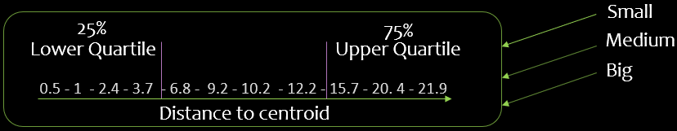
Algorithm performance
For each object size I have sorted the list of the corresponding objects in ascending order in terms of distance to the centroid
I have computed the 2 quartiles (lower and upper) for each size
Lists:
quartile
Comparing the «distance to the centroid» with «quartiles» we compute (Ns,Nl,Nm)
Se = 100 ∗ (1 −(Ns + Nl + (Nm/2) )
n
“Ns” = the number of small objects that have a distance to the centroid > than the lower quartile range of either the medium or the large objects
“Nl” = the number of large objects that have a distance to the centroid less than the upper quartile range of either the medium or the small objects
“Nm” = the number of medium objects that have a distance to the centroid greater than the lower quartile range of the large objects, plus the number of medium objects that have a distance to the centroid less than the upper quartile range of the small objects. This count is then divided by two to prevent bias

Slide 16
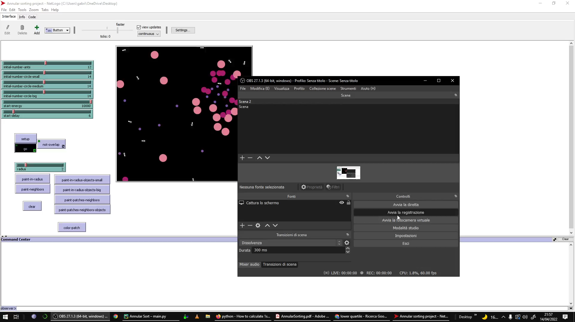
The experiment Results

Slide 17
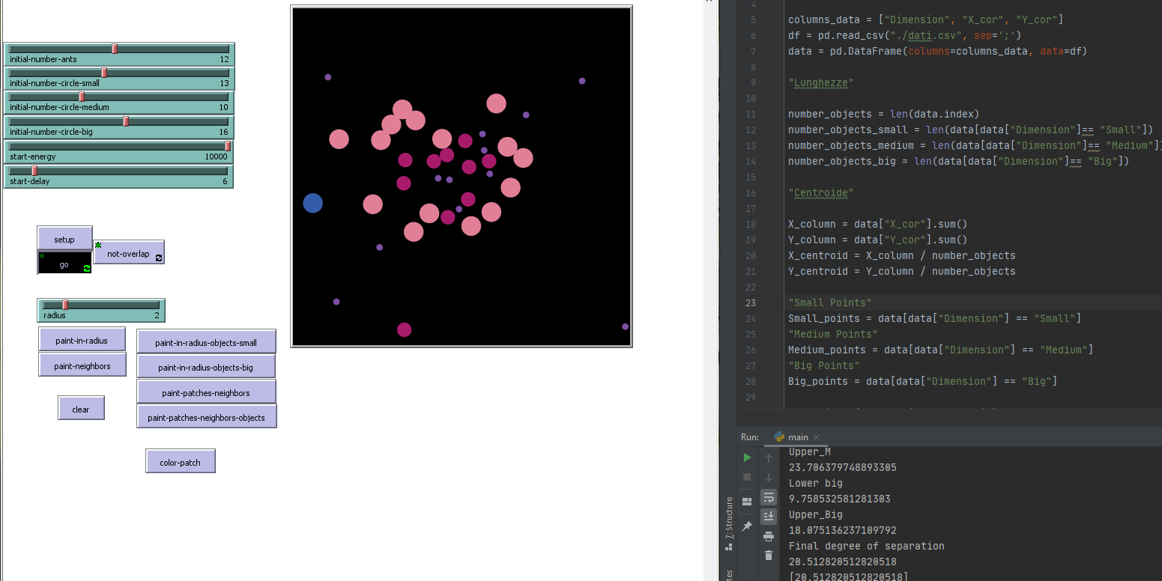
Some problems
Not always good sort -> Low value in percentage of Separation(20%).
Why?
«Little objects» may be too small to produce an high score and consequently they are less considered by the ants.
Not enought energy (even if it is 7 times bigger than the one in the paper).
The value of the delay could not be enough to allow the ants to «cool down».
Use of probability (lack of determinism).

Slide 18
Conclusions
The considerations below are beased on the simple observation of a set of attempts :
The experiments show that the ants are typically able to obtain a visible cluster in which small objects are positioned in the center of it.
Typically the value of separation that we can reach is about 40% considering an equal distribution of objects for each size.
The results show that when we don’t have the same number of objects (for each size) the annular sorting is not working as well as having an equal distribution, it encounters more difficulties to create a visible cluster and it requires more attempts, but the final separation values are not too different.
The separation results are not exciting maybe because some small objects could remain too much far from the cluster (not inside) and this may cause a shift of the centroid.
Typical result for a visible cluster
N° of objects of each size | Separation
Equal | 35~40%

Slide 19
…thank you!

